Slide 1

When Cyber Meets the Spectrum
Satellite Cybersecurity and the Convergence of SIGINT, ICS & AppSec
Norris Cornell | BSides Delaware 2025

Slide 2
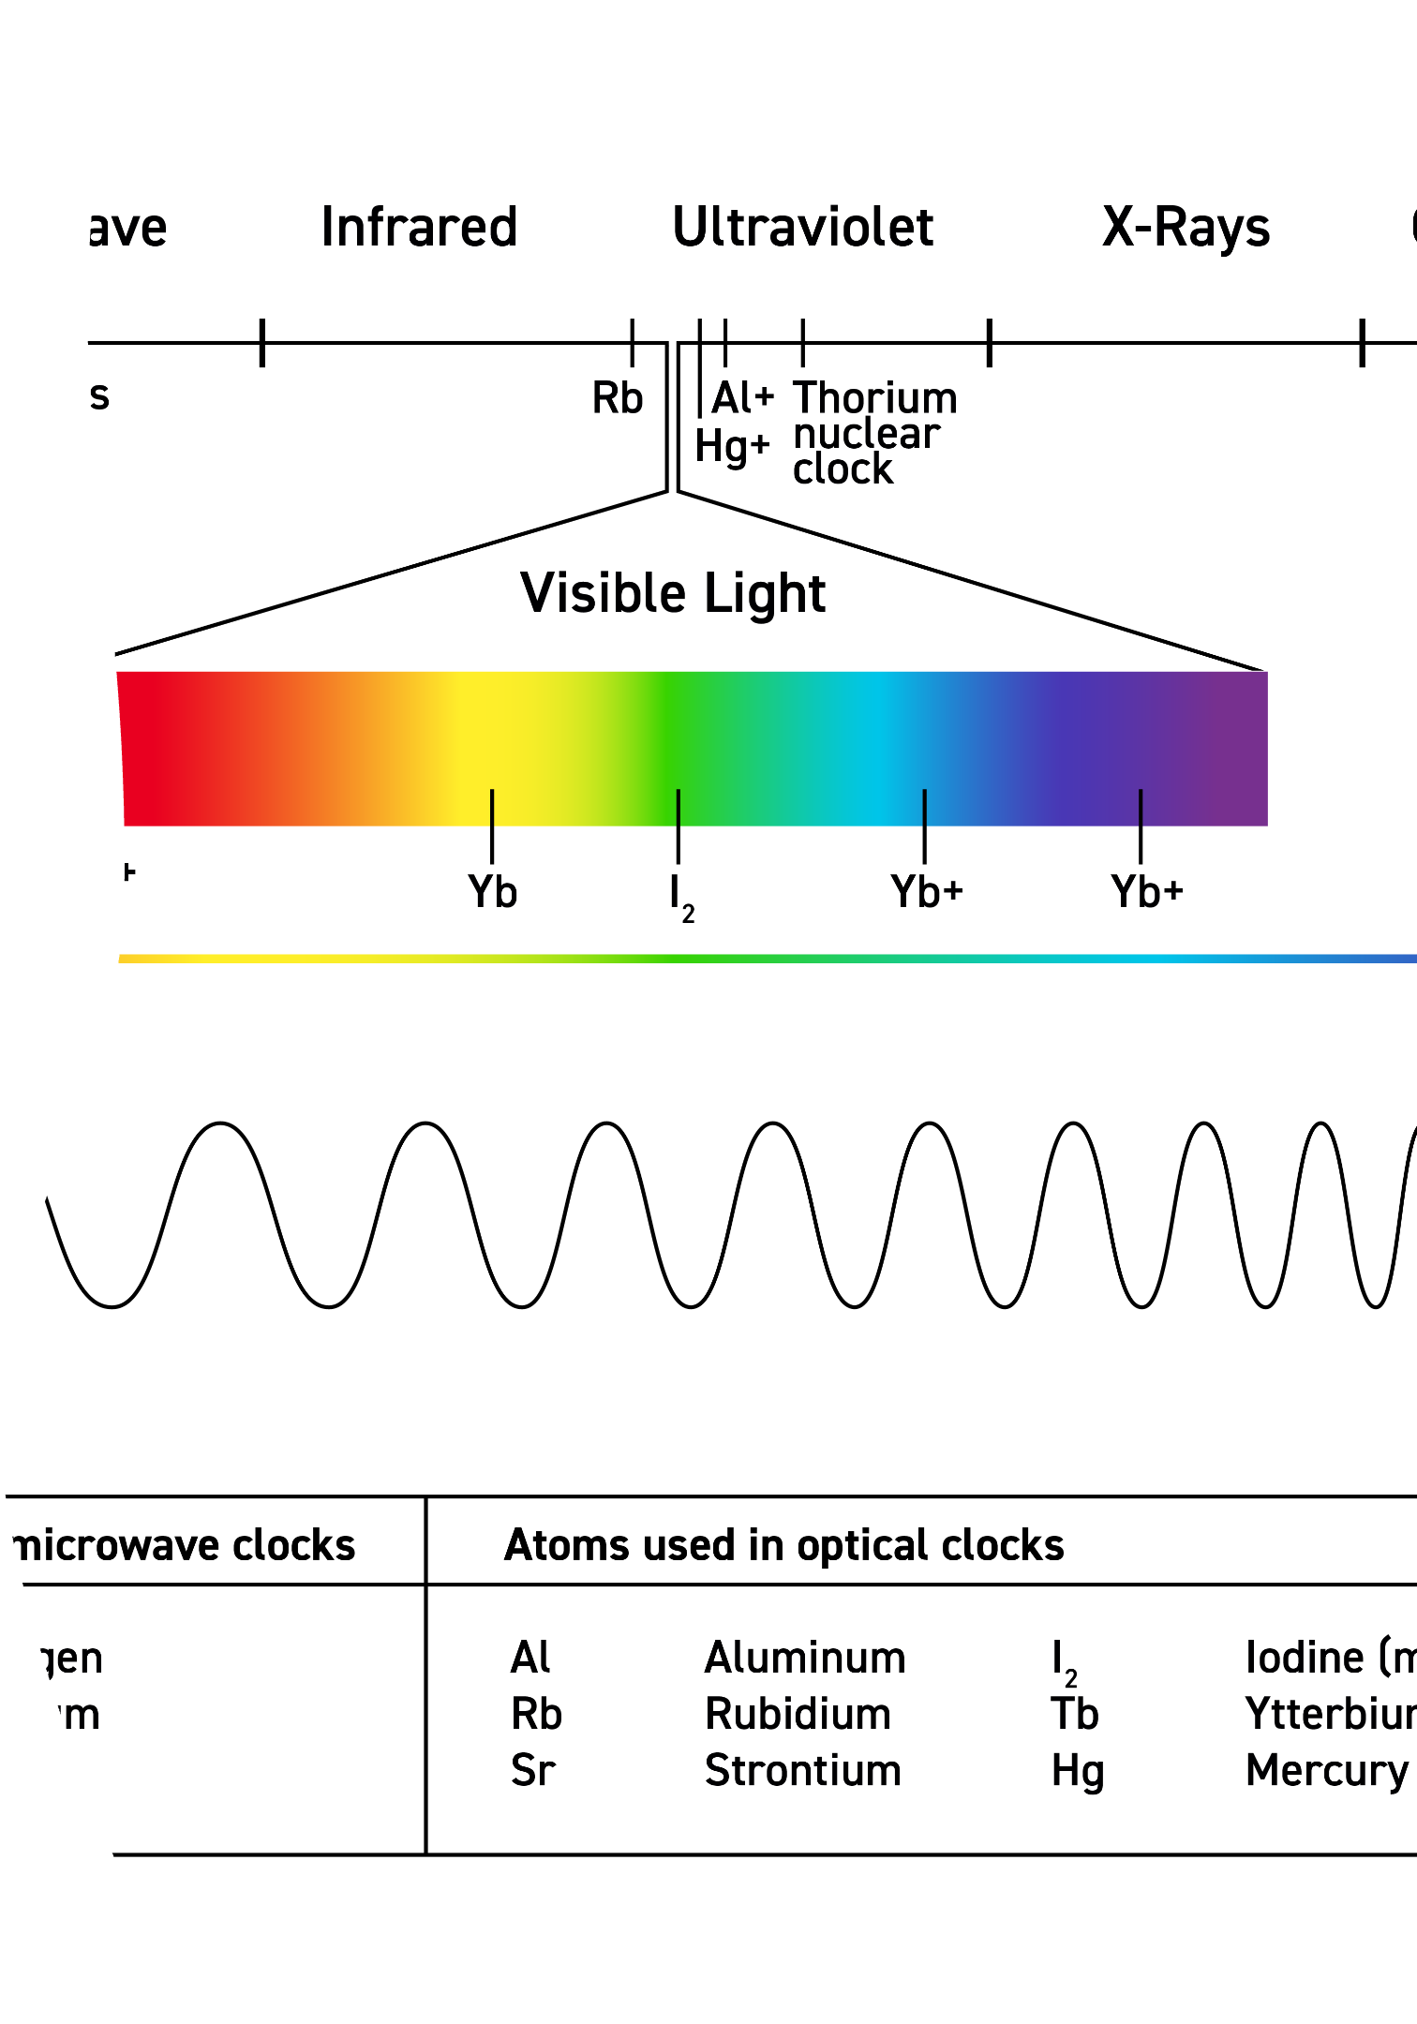
The Invisible Layer
Every millisecond of uptime depends on signals we can't see
Satellites enable timing and synchronization for critical systems
These signals are trusted but rarely verified
The invisible layer quietly sustains global operations

Slide 3

About the Speaker
Norris Cornell
Electrical engineering background; former electronics technician
MS in SCADA Cybersecurity (Wilmington University)
Blue Team and IAM Specialist with controls experience
Researcher focused on Satellite and OT Security
Presenter: BSides Delaware 2025

Slide 4
What This Talk Is
Not an Attack Tutorial
Awareness of RF-Layer Threats
Broadening Defenders' Visibility
No hacking walkthroughs or exploitation steps
Where cybersecurity meets the physics of signals
Extend monitoring beyond endpoints and networks
No offensive demonstrations or tools shown
How radio interference and spoofing affect systems
Include RF and spectrum in threat models
Focused on awareness and defense
Real-world cases: GPS, satellites, SCADA
Help defenders see what adversaries already know

Slide 5

Three Domains Collide
Where Industrial Control Systems, Signals Intelligence, and Application Security overlap — hybrid threat surfaces emerge that exploit vulnerabilities across all three domains simultaneously.
ICS/OT • Legacy protocols & weak encryption • Safety-critical devices at risk
Spoofed sensor/control signals
Vulnerable HMIs and gateways
Hybrid threat surface
Signal-layer tampering + insecure apps
SIGINT • RF spoofing & jamming • GPS/GNSS timing attacks
AppSec • Software & API vulnerabilities • Misconfigurations exposing services
Attackers exploit the gaps where software, hardware, and signals converge.

Slide 6




The Cyber-Physical Stack
SCADA = Brain
Makes decisions based on incoming data and sends control commands to field devices.
Communications = Nervous System
Satellites and networks transmit signals between the brain and muscles.
Field Devices = Muscles
Execute physical actions based on commands received from SCADA systems.
When signals are corrupted, the brain misfires — and critical infrastructure reacts to false information.

Slide 7
IT vs OT Security Priorities
Understanding the fundamental difference in security priorities is critical when defending operational technology environments.
IT Security
OT Security
Confidentiality — Keeping data secret
Safety — Preventing harm
Integrity — Ensuring data accuracy
Availability — Continuous operation
Availability — Maintaining uptime
Integrity — Accurate control signals
Downtime can mean damage or danger.

Slide 8
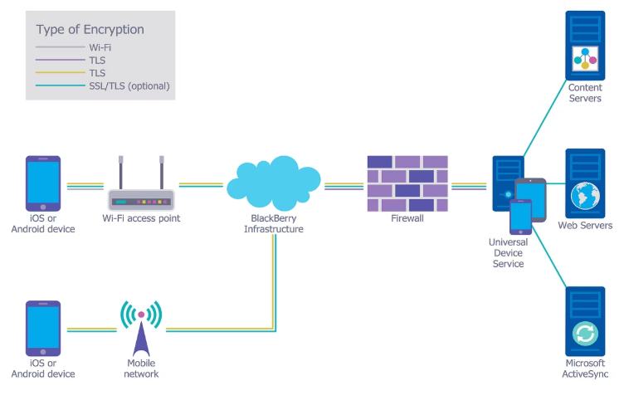
The Satellite Blind Spot
01
02
03
ICS Protocols Lack Encryption
Firewalls Can't See RF Layer
Attackers Strike Before Packets Exist
Many OT protocols send data in plain text
Firewalls inspect packets, not raw signals
No built-in authentication or integrity checks
RF manipulation happens before data formation
Compromise occurs at the signal source
Timing or data spoofing misleads control systems
Easy targets for spoofing or command injection
Traditional tools can't detect spectrum attacks
Defenses fail before data even reaches the network

Slide 9

Viasat Attack Timeline – 2022
A closer look at the sequence of events that led to a major satellite network disruption.
Credential Breach
Weak or reused VPN credentials exploited, granting initial access.
VPN Access Gained
Attackers successfully entered the satellite ground control network.
Admin Console Compromised
Control plane accessed, allowing remote issuance of commands.
Malware Deployed (AcidRain)
Destructive wiper malware sent to thousands of modems.
Terminal Destruction
Over 5,800 modems wiped and rendered permanently offline.
Cascading Outages
Widespread disruption across European power grids and wind farms.

Slide 10

Proving the Threat: UT Austin GPS Spoofing Research
UT Austin researchers demonstrated low-cost GPS spoofing using SDR hardware
Used a $3,000 software-defined radio rig to take control of a GPS-guided yacht
Demonstrated the ability to shift GPS signals without alarms being triggered
The ship's systems believed it was on course — even as it drifted off
Proved that critical infrastructure relying on GPS can be silently deceived
Today, similar spoofing kits can be built for under $500

Slide 12
Traditional attacks target networks. Satellite attacks target signals — before networks even see them.

Slide 13
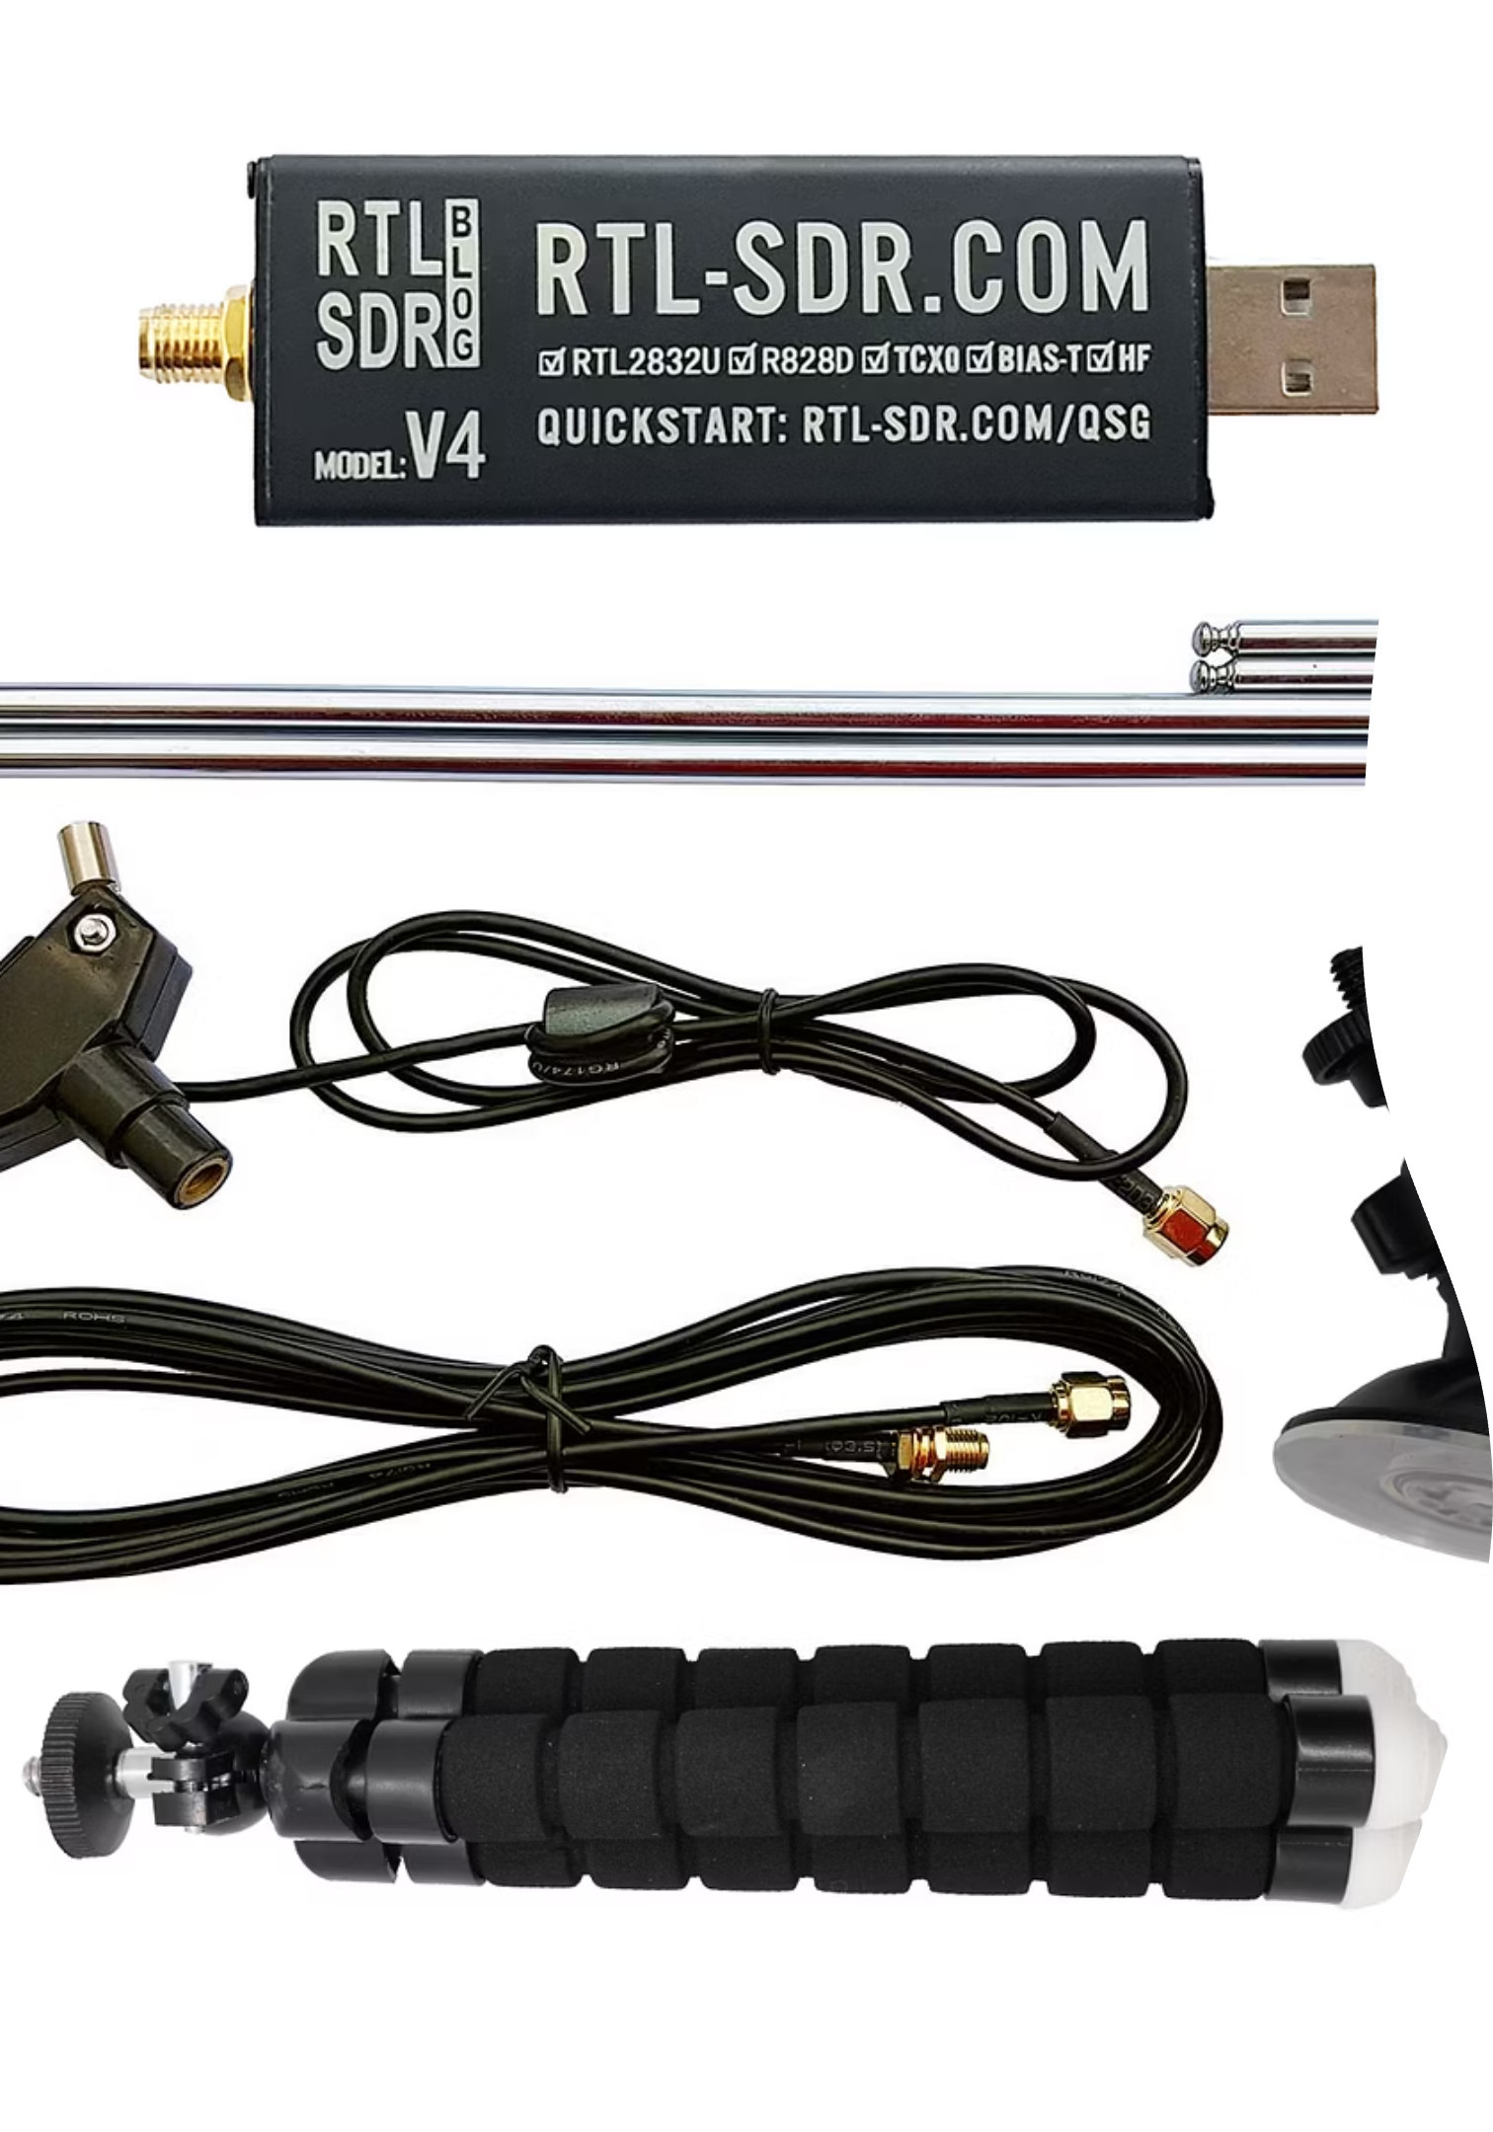

GNSS Spoofing 101
Attackers use low-cost SDR equipment to broadcast false GPS signals
Spoofed signals overpower authentic ones, silently deceiving receivers
Timing and location data are manipulated — with no alerts triggered
Real Signal Transmitted
Authentic GPS satellites broadcast timing and location data
Fake Broadcast Overpowers
Attacker transmits stronger false signals using SDR equipment
Receiver Deceived
Device locks onto fake signal and reports false timing or location

Slide 14
Attackers capture legitimate GPS signals and rebroadcast them with a delay
Even 2–3 second timing shifts can desynchronize control systems
Small delays trigger phase errors, false readings, and critical disruptions
Power Grid
Maritime AIS
SCADA & 5G
2–3 second GPS delay skews timing signals
GPS spoofing creates "ghost ships"
Lost sync between distributed systems
False phase angles trigger relay misfires
Vessels appear hundreds of meters off course
Timing drift disrupts control commands
Causes grid instability or localized outages
Increases collision and navigation risks
Causes network handoff and automation errors

Slide 15

When the Orchestra Falls Out of Sync
ICS systems operate like orchestras — every device plays its part based on a shared timing source.
When timing drifts, controllers and sensors fall out of sync.
The result: false readings, unnecessary shutdowns, and data chaos.
Even a 1-second delay can turn harmony into chaos.
A single timing delay can make the entire system play out of tune.

Slide 16
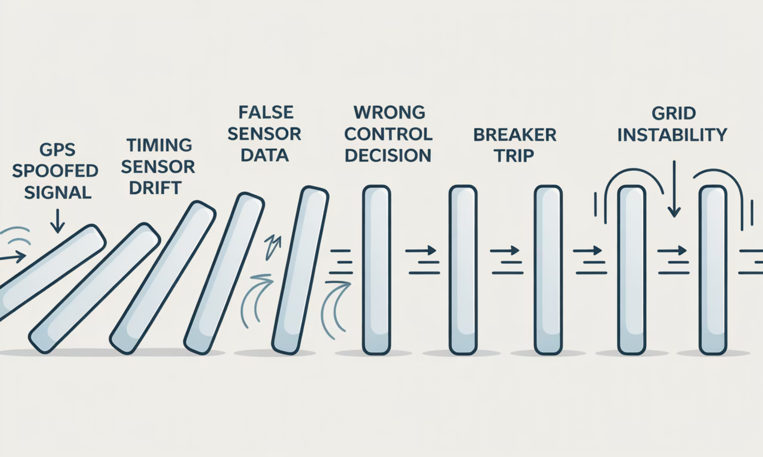
When the Dominoes Start to Fall
ICS failures often start with one bad data point.
False timing or sensor input triggers wrong control actions.
Those actions cascade across interconnected systems.
Small timing errors can cascade into large-scale outages.
In complex systems, one false signal can start a chain reaction.

Slide 17
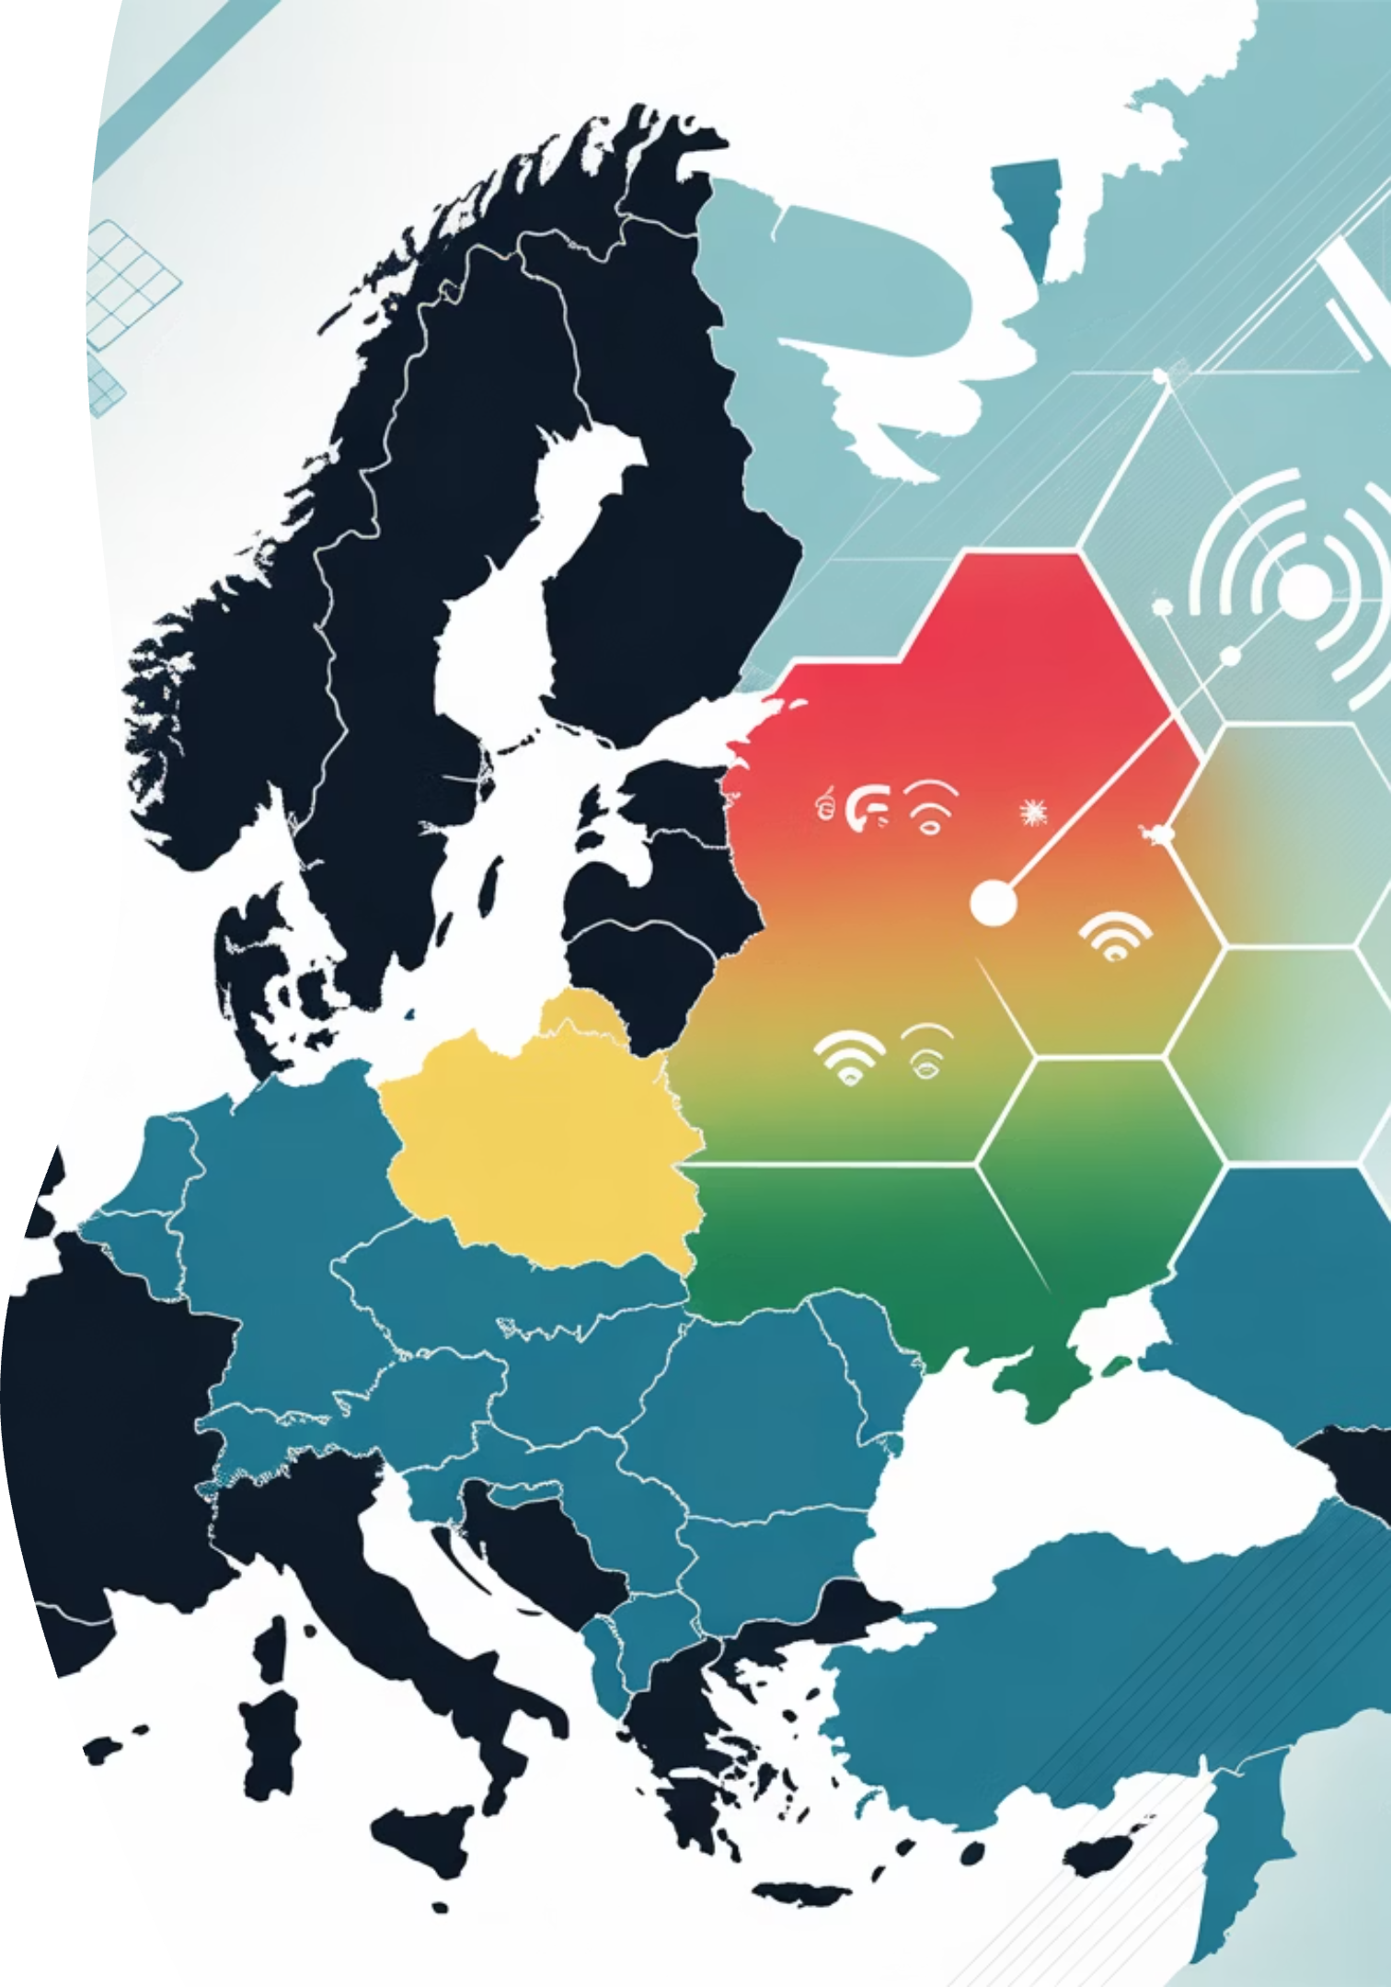
Ukraine: A Live GPS Warfare Testbed
The conflict in Ukraine showcases operational GPS warfare, with documented attacks confirming these threats are real and active.
Overview:
Ukraine has become the world's first large-scale GPS warfare testbed
Thousands of real interference events confirm active signal attacks
Key Metrics:
1,200+ GPS disruptions (2025 alone)
300+ ghost ships per month (false AIS data)
2–3s timing delays disrupting automation
Takeaway:
Even small timing shifts can mislead power grids, ships, and comms systems
These attacks prove GPS spoofing is operational — not theoretical

Slide 18
Hybrid Attack Surface
When Cyber Meets the Spectrum
RF manipulation combines with software vulnerabilities to create hybrid attacks that evade traditional security controls. These attacks operate across multiple layers simultaneously.
RF Layer
Network Layer
Application Layer
Spoofing, jamming, and relay-delay attacks
Corrupted data appears as legitimate traffic
False data triggers incorrect automation actions
Manipulates physical signal layer before data forms
Perimeter defenses fail to recognize altered timing
Software trusts bad input without validation
Undetectable by most traditional cybersecurity tools
Bridge between physical and logical compromise
System errors ripple through critical operations
New blind spots emerge where physics meets logic — attackers exploit the gaps between disciplines.

Slide 19
Defense-in-Depth Strategy
Protecting against satellite-layer threats requires visibility and validation across all layers — from RF monitoring to operator training.
RF Layer Defense
1
GNSS hardening, spectrum monitoring, and signal authentication to detect spoofing and jamming attempts.
Network Layer Defense
2
SATCOM DMZs, encryption, and segmentation to isolate satellite communications from critical systems.
Application Layer Defense
3
Timestamp validation, input sanitization, and anomaly detection to catch manipulated data.
Operational Defense
4
Training and tabletop exercises to prepare operators for degraded satellite conditions.

Slide 20
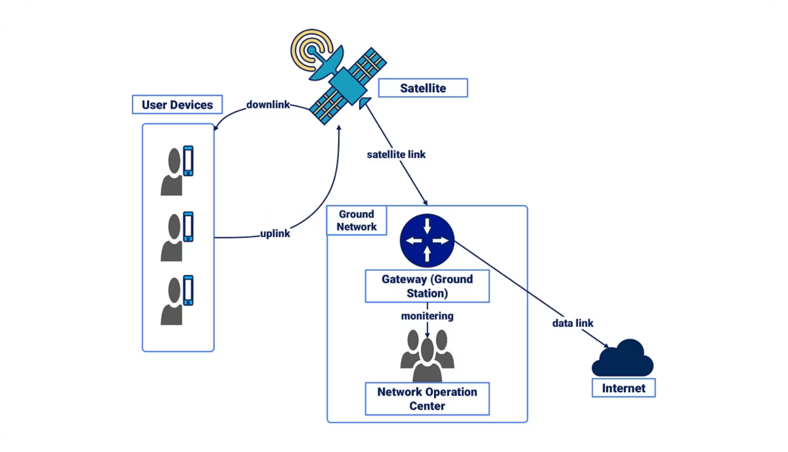
Monday-Morning Actions
You Don't Need a Million-Dollar Lab to Start
1
Add Satellites to Threat Models
Add satellites, GNSS, and SATCOM to your threat models
Acknowledge RF-layer risks in your attack surface
Include timing signal dependencies in assessments
2
Inventory Dependencies
Identify systems that rely on GPS timing or satellite comms
Document gaps in visibility or monitoring
Spot where GNSS disruption could affect safety or uptime
3
Implement One Control Now
Start with timestamp validation or GNSS monitoring
Choose one actionable step to harden your environment
Deploy a visible control this week — even if small

Slide 21

The invisible layer is now visible. What will you do about it?

Slide 22
Key Takeaways
Visibility
Validation
Action
Satellites are in your architecture but not your risk assessments — make them visible
Traditional controls can't see RF-layer attacks — validate inputs at every layer
Adversaries already know these vulnerabilities — defenders must catch up now

Slide 23
Resources & Acknowledgments
Organizations
Standards & Guidance
Space ISAC
NIST SP 800-82 Rev 3
DEF CON Aerospace Village
NIST IR 8401
Hack-A-Sat Competition
IEEE 1588 (PTP)
IEEE C37.118 (Synchrophasors)
These resources and communities provided the foundation for this research — from NIST and IEEE standards to hands-on learning at DEF CON Aerospace Village.

Slide 24


Thank You
Norris Cornell
SCADA Cybersecurity Professional
CornellSecurity | cybersecurity
Cornell Security | BSides Delaware 2025
Contact Information:
Email: npcornell@gmail.com
LinkedIn: Scan to Connect
Questions?
Connect with me on LinkedIn, scan the QR code, or visit CornellSecurity.com to continue the conversation about satellite cybersecurity and OT defense.

